Slide 1

NEXTGEN LIBRARY PORTAL
By amitha, vidya and deekshitha

Slide 2
overview
Objectives
Problem Statement
Introduction
Requirements
Concepts Used
Classes and Methods
Design
Conclusion

Slide 3

OBJECTIVES
Build a simple and efficient library system using Python.
Use OOP concepts like encapsulation and inheritance.
Allow students and faculty to borrow and return books.
Apply different loan rules and fines for each member type.
Store all data in text files using UTF-8 encoding.
Use list comprehension to simplify data handling.
Design the system to be easy to extend or upgrade later.

Slide 4

Problem Statement
In many libraries, managing books and members is still done manually or with very basic tools. This often creates problems like books getting misplaced, due dates being missed, or members not being tracked properly. Students and faculty have different borrowing needs, but most manual systems don’t handle those rules well. Also, when data isn’t stored properly, all records are lost once the system is closed. This leads to confusion, errors, and extra work for library staff. To solve these challenges, our project — NextGen Library Portal — provides a digital system that makes library management simpler, faster, and more reliable.

Slide 5

INtroduction
The NextGen Library Portal is a Python-based system that simplifies library management. It helps librarians add books, enroll members, track borrow/return, and calculate fines automatically. Built using OOP principles, with UTF-8 encoding for universal text support and list comprehensions for efficiency, it provides a fast, reliable, and user-friendly digital solution for libraries.

Slide 6
requirements
User Interaction (CLI): A clean, menu-driven interface is needed so that students, faculty, and librarians can easily perform actions like inserting books, enrolling members, borrowing, or returning books without confusion.
Data Management (Books & Members): The system should maintain accurate records of all books and members. This includes book details (ID, title, author, availability) and member details (ID, name, borrowed books).

Slide 7
Borrow & Return Rules: Different borrowing rules must be applied for students and faculty (e.g., borrowing limits, due dates), ensuring fairness and accountability.
File Storage (Persistence): Data should not be lost when the program closes. Hence, books and members must be stored in text files (ng_books.txt, ng_members.txt) in UTF-8 encoding, ensuring compatibility and proper handling of special characters.
Automation & Efficiency: The project should use list comprehensions and Python features to make operations like searching, filtering, and saving data more compact and efficient.

Slide 8
Concepts used
Object-Oriented Programming (OOP): The system is built around classes like Book, Member, and LibraryPortal. Each class represents a real-world entity, making the program more modular and easier to manage.
Encapsulation: Member details and borrowed books are kept private inside the class. They can only be accessed or modified through methods, ensuring data security and correctness.

Slide 9
Inheritance: Common features are defined in a BaseMember class, while StudentMember and FacultyMember inherit from it. This avoids duplicate code and allows each type of member to follow their own borrowing rules.
Polymorphism: The same action (like borrowing a book) works differently depending on whether the user is a student or faculty, thanks to method overriding.

Slide 10
Separation of Concerns: The design keeps responsibilities separate: Book and Member handle data. LibraryPortal manages operations. CLI provides user interaction. This makes the system easier to extend and debug.
List Comprehension: Used for tasks like filtering borrowed books and preparing data for saving. It makes the code shorter, faster, and easier to read.
File Persistence with UTF-8: All books and members are saved in text files using UTF-8 encoding. This ensures that the data is not lost when the system is closed and supports names or titles in any language.

Slide 11
Classes and methods
Book Class Attributes: book_id, title, author, isbn, available Methods: to_line(): Converts book details into a text line for saving. from_line(line): Reads a line from file and reconstructs a Book object. __str__(): Displays book details in human-readable format.

Slide 12
BaseMember (Abstract Class) Attributes: member_id, name, __borrowed (list of borrowed books) Methods: borrow_book(book): Borrow a book. return_book(book_id): Return a borrowed book. to_line(): Save member and borrowed books into a text line. from_line(line): Load member details back from file.
StudentMember (Subclass of BaseMember) Attributes: Inherits from BaseMember Methods: Override borrow rules (max 3 books, 14 days limit).

Slide 13
LibraryPortal (Controller Class) Attributes: books (list), members (list) Methods: insert_book() → Add a new book. discard_book() → Remove a book. enroll_member() → Add a new member. borrow_book() → Borrow process. return_book() → Return process. save_data() / load_data() → Persist data in UTF-8 files.

Slide 14
FacultyMember (Subclass of BaseMember) Attributes: Inherits from BaseMember Methods: Override borrow rules (max 5 books, 30 days limit).
CLI (run_cli function) Provides a menu-driven interface for the user. Calls LibraryPortal methods based on user input.

Slide 15
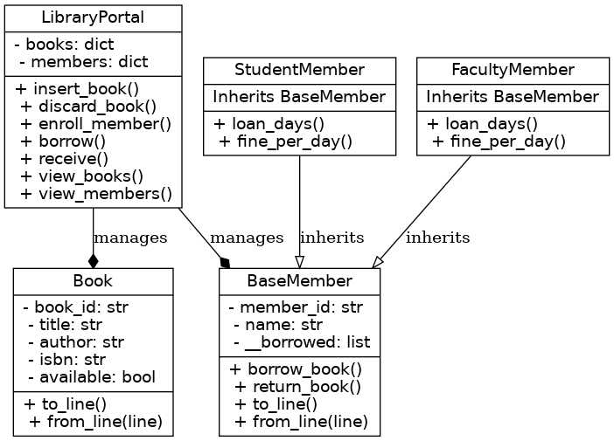
design

Slide 16
Book Class → Represents books in the system.
BaseMember Class → Abstract parent class.
StudentMember / FacultyMember → Inherit from BaseMember.
LibraryPortal → Manages books and members (composition relationship).

Slide 17
conclusion
The NextGen Library Portal has shown how Python and OOP principles can be used to build a simple yet powerful system. It allows users to easily manage books, enroll members, borrow and return items, and even calculate fines automatically. By applying concepts like encapsulation, inheritance, polymorphism, list comprehensions, and UTF-8 encoding, the project demonstrates how real-world problems can be solved through thoughtful coding and design.

Slide 18
Thank you

